Slide 1
CIP Process Improvements
UNCC Airport Engineering Seminar
October 14, 2019

Slide 2
THE BAD AND THE UGLY

Slide 3
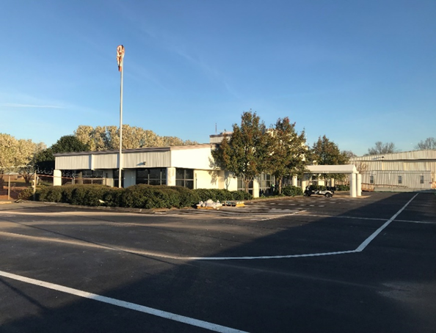
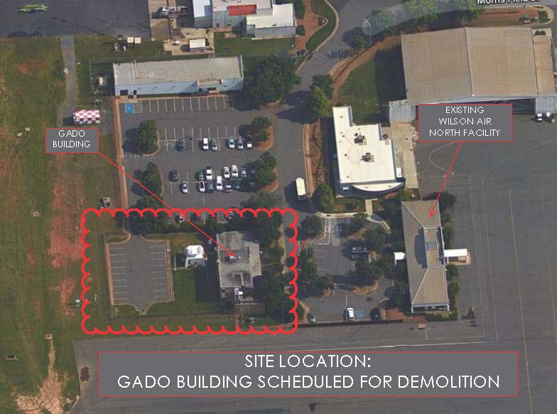
Wilson Air Charter Terminal Renovations
Initial Project Budget of $5 Million for an intensive renovation. The purpose and need was to provide higher level of service for charters and international customers.
2017
2017

Slide 4
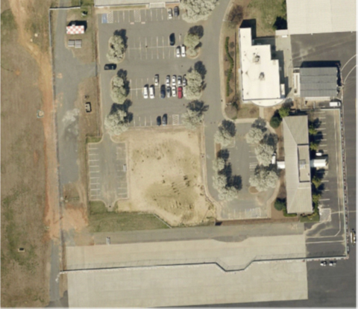
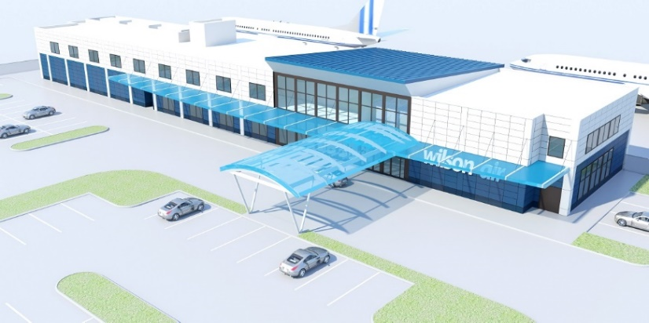
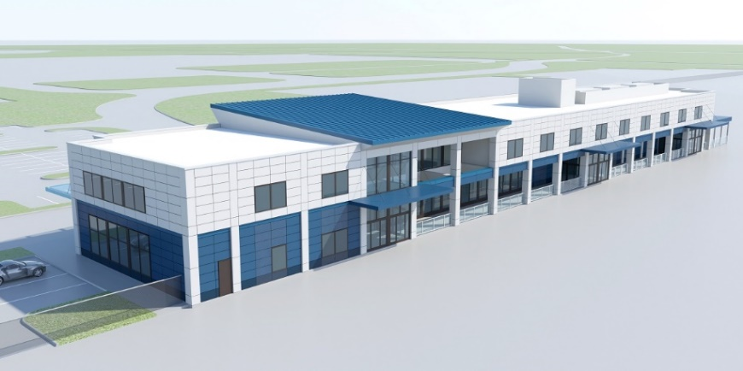
Wilson Air Charter Terminal Renovations

Slide 5
Wilson Air Charter Terminal Renovations
Project Costs grew to $21-22M
Rental Proforma didn’t indicate positive ROI
Lack of available funds in specific Funding source
Now going back to enhanced interior renovations

Slide 6
Change and impacts to the cip

Slide 7
Change and Impacts to the CIP
How Did We Get Here?
Historic CIP Process up until 2013
  Development owned list of new Capital projects
  Limited capital development over the years
  The goal up until 2010 was approximately $150 Million annually
  Investments for Operating requirements not included in the CIP
  Prioritization was not financially critical
  Cost Estimates developed very early in project life cycle with requirements not fully developed
  List of true capital projects was reviewed and approved annually
  Limited change to annual list

Slide 8
Change and Impacts to the CIP
What Triggered Change?
2013-2016: Significant Changes at CLT
  Political shift
  Leadership change
  Hub Airline merger
  Substantial population growth in the region
  Continuous growth in passenger traffic
  Airfield Capacity Enhancement Plan/Terminal Capacity Enhancement Plan
  Significant amount of facilities and infrastructure overdue for improvements
  Capital development skyrocketed (double)

Slide 9
Change and Impacts to the CIP
Potential High Risk Impacts to the CIP With This Change
Projects added at an unprecedented rate
    Projects added informally and without full communication among leadership
    Ideas or projects added without proper validation for scope, cost and schedule
    Projects advance directly from “idea” into design/execution
        This can lead to massive scope creep
      Projects getting ahead of divisional input/requirements and without alignment with broader CIP
      Logistical complications develop between projects
  Disconnects between the CIP and the Financial Plan

Slide 10
Change and Impacts to the CIP
Projects Significantly Impacted
  Joint Operations Center, $28 Million
  Concourse E Expansion Ph 8/9, $47 Million
  Wilson Air Charter Terminal Renovations, $18 Million
  Terminal Renovations, $95 Million
  North End Around Taxiway (NEAT), $253 Million

Slide 11
Change and Impacts to the CIP
Response to Change
Recent Changes and Improvements to CIP Process
CIP process as a tool began to change
CIP became a single place for all capital spending
    Operational Capital (buses, IT, maintenance rolling stock, etc)
    Capital development (new facilities as well as major improvements)
Incorporated funding and cash flow into the spreadsheet
CIP Request form created to track and rank requests
Began Monthly Director’s CIP review
Began Monthly Chief Officer’s review

Slide 12
Accuracy of information
How is the information vetted before input into the CIP?

Slide 13
Proposed Process Improvements
Project Validation
Planning and Finance agreed the #1 issue at the beginning of this effort was the inaccuracy of the information provided in the CIP (ie. the cost estimates, back of napkin scopes)
Project Validation Reports – Five Sections:
  Project Description
  Conceptual Cost Estimate
  Estimated Project Schedule
  Funding Analysis
  Cash Flow

Slide 14
Proposed Process Improvements
Project Validation
  Project Description
    Full written description of the project/asset type; general scope, size, site location, etc.
    Should include graphics and information from previous planning studies, conceptual drawings, plans and any other relevant information.
    This information can be used for justification and content for PFC Applications, Council Actions, etc.
  Conceptual Cost Estimate
    This will be a high level estimate based on the project description above.
    The more information known at the time, the further refined the estimate can be. However, in the conceptual stage and for initial input into the CIP, higher project contingencies are recommended.
    As the project progresses through design, further refinement in scope and cost should be continuously tracked

Slide 15
Proposed Process Improvements
Project Validation
  Estimated Project Schedule
    Start and End dates for Design Schedule
    Start and End dates for Construction Schedule
    These dates should be tracked in the CIP and aligned with project estimates
  Funding Analysis
    Recommendations for project funding
    Where applicable, diagram of floor plan with breakdown of functional spaces as it relates to PFC, CFC, and AIP eligibility
  Cash Flow
  Forecasted cash flow projection based on project schedule
  Broken down by funding source

Slide 16
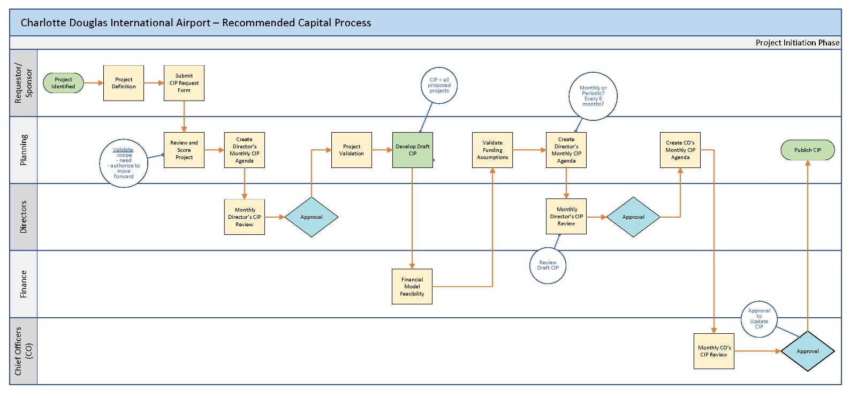
Proposed Process Improvements
Project Initiation Process Flow

Slide 17
Proposed Process Improvements
CIP & Planning Process
Updated CIP process flow chart
Clear focus on standard process to develop scope, schedule, budget, cost estimates, funding plan, and prioritization
Clear decision points for cross-functional review and approval
Funding and finance feasibility assessed with appropriate info
Complete Project Validation Reports for all current projects
Develop method for calculating project contingency
Identify appropriate spending levels for Operating Capital projects on fiscal year basis

Slide 18
Proposed Process Improvements
Why Prioritize?
    Aligns project development with CLT’s Vision and Mission Statements and organizational goals and objectives
    Focuses spending on projects with most positive impact
    Sets clear priorities for cross-divisional interaction
    Allows the limited resources to focus on most important needs
      Staff
      Capital Funding
      Operating Capital Funding

Slide 19
Proposed Process Improvements
Prioritization Steps?
  Determine how much money you can afford to spend
  Use ranking criteria to assess and rank each project on list
  Determine projects on list that can be accomplished based on ranking and available funding
  Regularly re-evaluate list based on actual projects costs and available funding

Slide 20
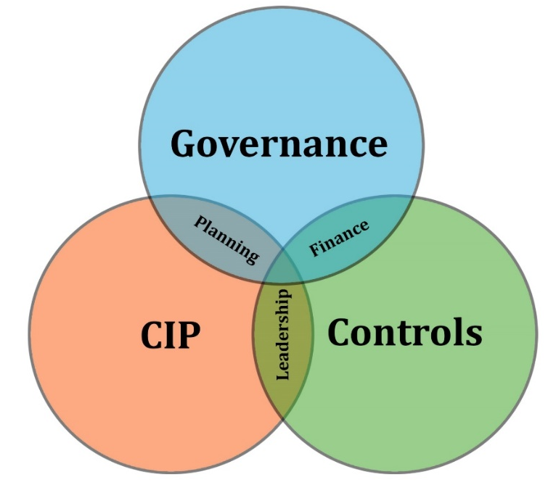
Proposed Process Improvements
Critical Elements of a Successful Program

Slide 21
Program Controls
Implementing a Large Capital Program
  Provides for consistent project tracking and reporting
  Ability to easily track changes, errors & omissions
  Provides reliable information about entire CIP and in a consistent format
      Actual spent/encumbered
      Forecasting vs baseline budget and schedule
  Independent review of cost estimates and schedules

Slide 22
Governance
Implementing a Large Capital Program
  Cross-functional layered management of CIP
    Review and Oversight from multiple perspectives
  Decision-making occurs at appropriate levels
    Directors review and recommend initially
    Chiefs confirm and approve
  Consistent forum to discuss and agree direction
  Positive decision-making around contingency use
  Centralized documentation and reporting of CIP
    Meeting minutes, record of decisions and basis

Slide 23
Governance
Do you want to have formalized committee(s) or group?
  Strategy Committee
      CBIO, COO, CFO, Planning Dir., Business and Revenue Dir.
  Finance Committee
      CFO, Finance Mgr, Planning Dir., Eng. Dir., Business and Revenue Dir.
  Construction Committee
    COO, Airport Engineer, Facility Dir., Technology Dir., Innovation and Experience Dir.

Slide 24
Program Controls & Governance
Organizational Benefits
  Alignment of decision making with strategic goals
  Better communication, coordination and teamwork
  Improved decision-making and buy-in
  Functional checks and balances
  Process accountability and documentation
  Transparency
  Monitoring of cost, budget, funding and schedule

Slide 25
Program Execution Plan
intended to be an executive management tool to ensure that key program activities are considered so that work can be performed in a coordinated, systematic, and formalized manner.
structured to identify critical action items desired by the organization needed to implement a large capital development program.
designed to be a dynamic document that is expected to be updated throughout implementation of the program, recognizing that many more major activities will be identified as the work progresses.

Slide 26
Goals for Process Improvement
Informed decision-making by CLT Leadership around projects competing for increasingly limited funds
Consistent and transparent process within the organization
  Improves staff communication and support
Reliable project data and information
Achievable funding and finance plan
Appropriate control points for decision-making
Organizational alignment on goals and priorities

Slide 27
Benefits of Improvements
Organizational Alignment and Communication
  Leadership and direction established at Chief level
  Goals and priorities clearly agreed and communicated
  Transparent process within organization
Achievable funding/finance plan based on reliable project data
  Minimize project planning and funding “on the fly”
Coordination and support between CLT divisions based on established goals and priorities
Efficient CIP implementation to serve passengers and stakeholders

