Slide 1
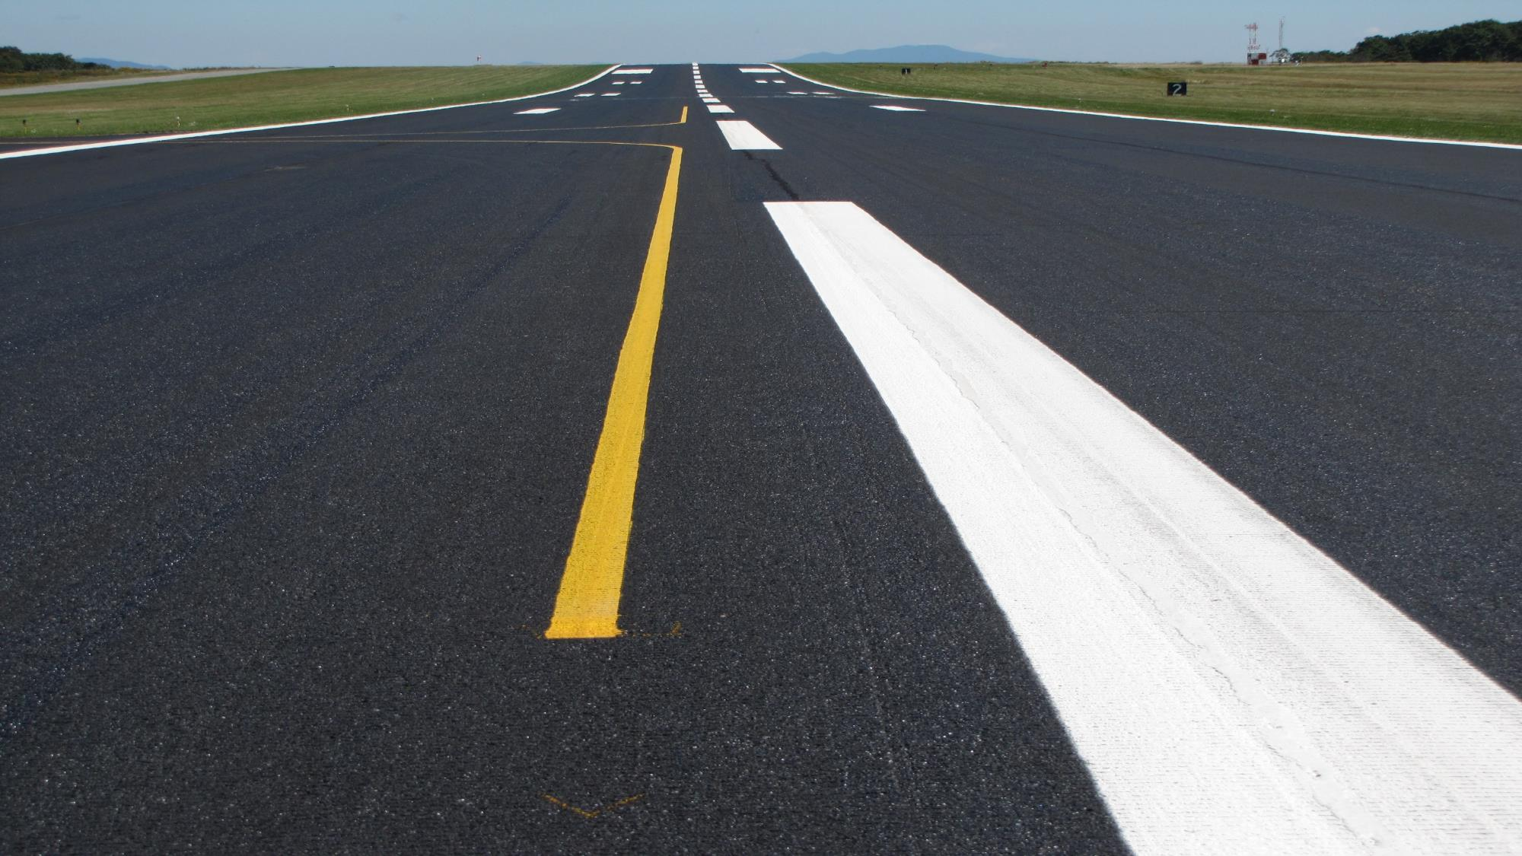
Airfield Markings
Changes to Advisory Circulars
Airport Engineering
Onsite Seminar
October 14, 2019
Sightline, Inc.
Airport Marking Consultants
Culpeper, Virginia

Slide 2
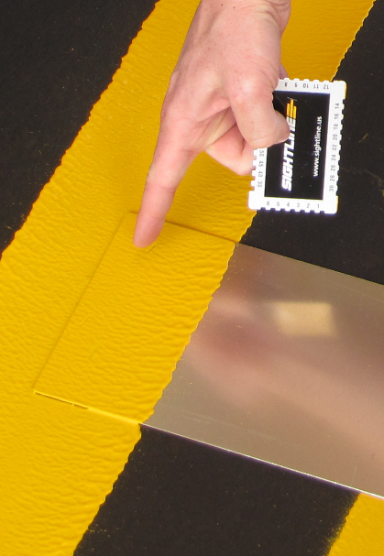
Overview
How has the “What, Where, and When” of airfield markings changed in AC 150/5340-1M?
What are the quality control measures that have been added to AC 150/5370-10H, Item P-620 – Airfield and Taxiway Markings
What aspects of the P-620 could be applied to the maintenance of airfield markings?
What responsibilities do consulting engineers and their RPRs have to ensure their clients inherit markings that are effective and will last?
If markings are the “icing on the cake”, how can engineers make sure they will have the desired effect?

Slide 3
Changes to ACs
AC 150/5340-1M – 5/10/19
AC 150/5370-10H –12/21/18 (Item P-620 – Runway and Taxiway Markings)
Reasons for the changes:
  Clarify guidance
  Improve industry standards
  Improve marking performance
  Quality Control measures

Slide 4
AC 150/5340-1M
May 10, 2019
Centering of Runway Landing Designation
Markings (Para. 2.3.5)

Slide 5
Footnotes on Numbers
All characters are 60-feet high and 20-feet wide
  unless otherwise specified.
Vertical stroke is 5 feet wide; horizontal stroke 10 ft.
All designations are spaced 15 feet apart, with
  exception to the number “11” (27’).
Single designations are centered on the runway
pavement centerline. For double designations, the
center of the outer edges of the two numerals is
centered on the runway pavement centerline.

Slide 8
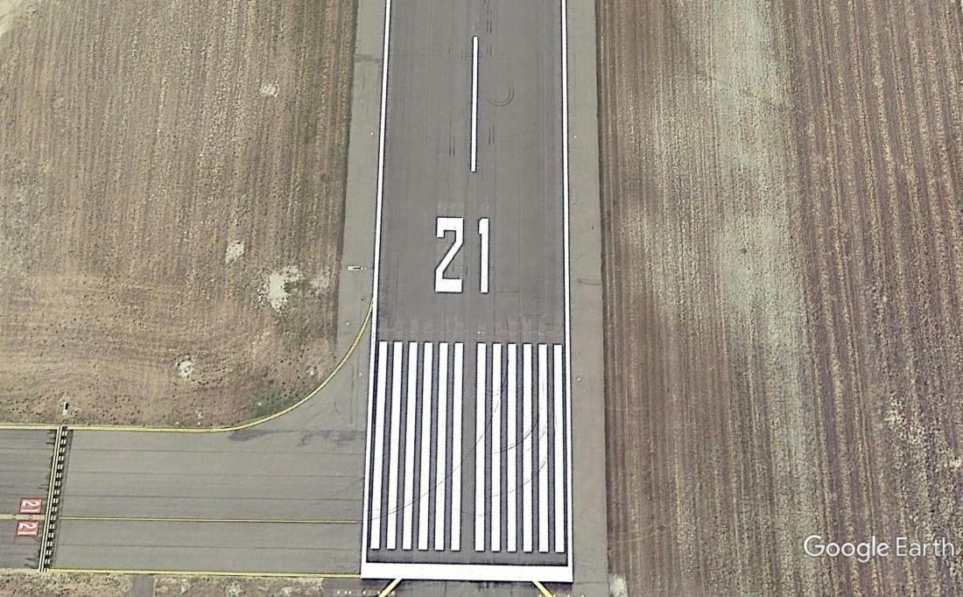
Center Runway Landing Designator Markings.
48 ft
64 ft

Slide 9
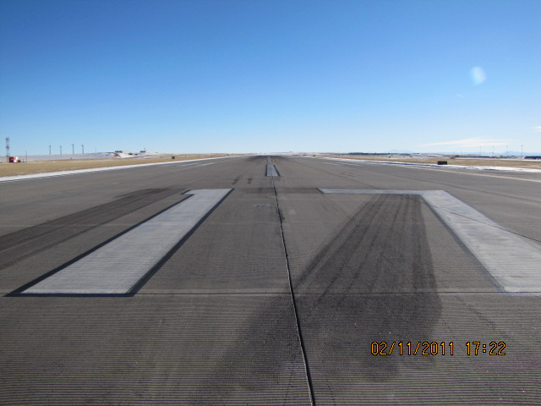

Slide 10
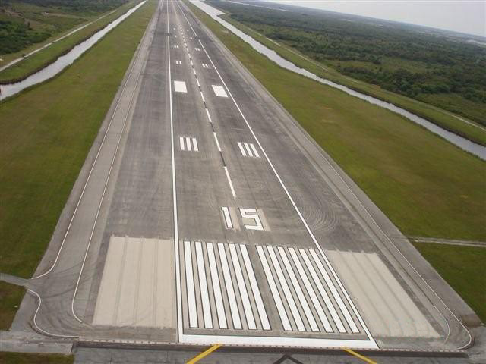
Center Runway Landing Designator Markings.
54 ft.
54 ft.

Slide 11
AC 150/5340-1M
May 10, 2019
No taxi islands – new definition – (Para 1.2.4)

Slide 12
Island. An unused paved or grassy area along a taxiway, between taxiways, between runways, or between a taxiway and a runway. Paved islands are clearly marked as unusable, either by painting or the use of artificial turf. For the purposes of this AC, certain islands are referred to as “No-taxi” islands.

Slide 13
Case 1 – To avoid taxiway excursions onto unpaved areas or paved areas not intended for use by providing pilots with visual cues to discern the edge of usable full-strength pavement.

Slide 14
Case 2 – To prevent runway incursions when terminal aprons are in close proximity to the runway by creating turning maneuvers with the use of no-taxi islands and reconfigured taxi routes.

Slide 15
Case 3 – To avoid runway incursions or wrong runway take-offs due to oversized entrance taxiway.

Slide 16
Case 3

Slide 17
Case 3

Slide 18
Case 4 – Intended to reduce incursions due to multi-entrance taxiways located on a single, expansive, paved area.
BEFORE

Slide 19
Case 4

Slide 20
Case 4 – Obtain standard width taxiways by inserting green no-taxi islands and creating individual taxiway entrances.

Slide 21
AC 150/5340-1M
May 10, 2019
Recommends training of personnel who
apply [or monitor] surface markings.

Slide 22
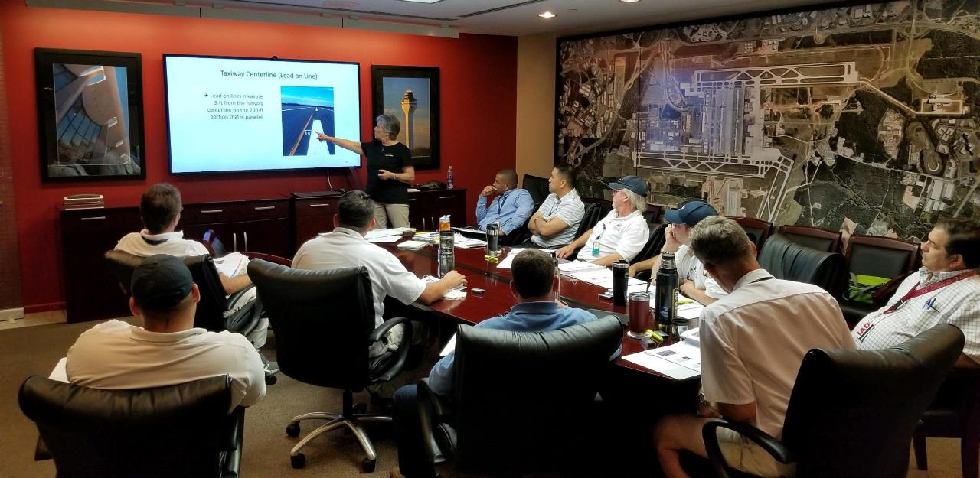
PILOT CERTIFICATE TRAINING AT DULLES INTERNATIONAL AIRPORT

Slide 23
4. Paragraph 1.3.8. The advisory circular makes the recommendation for training of personnel that perform [monitor] the application of surface markings, prepare surfaces to receive surface markings, remove markings, etc., as important aspects to obtaining desired markings and longevity.

Slide 24
AC 150/5340-1M
(continued)
Any stencils used must not leave stencil gaps (Para. 1.3.9)

Slide 25
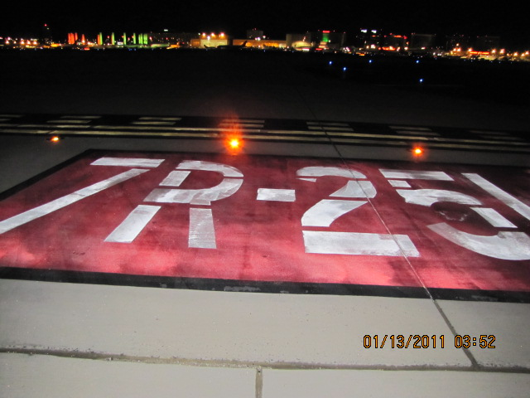
Fill in stencil marks on surface painted signs

Slide 26
In all cases, inscriptions follow Appendix B inscription criteria.

Slide 27
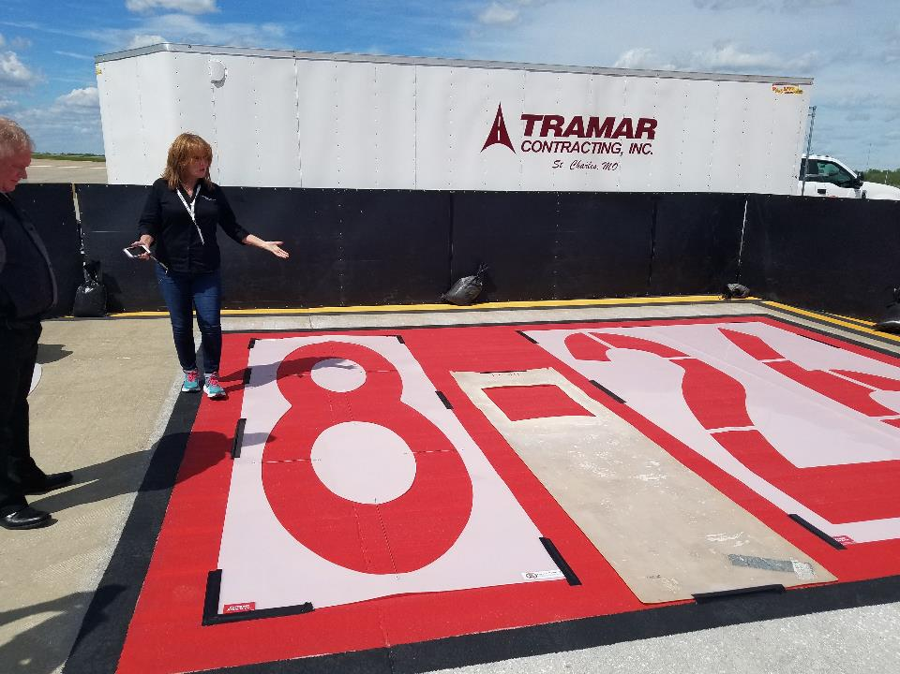

Slide 28
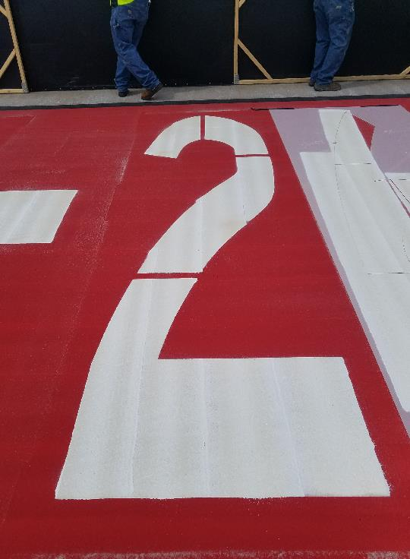
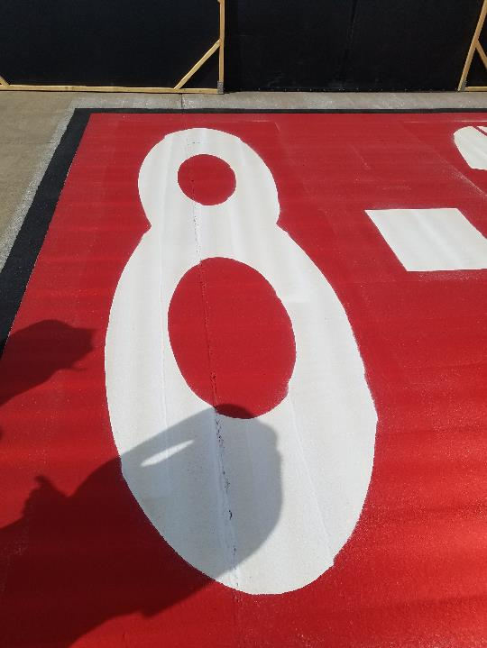

Slide 29
AC 150/5340-1M
(continued)
Added notes to Table 1-1 and Table 1-2 to clarify the use of black borders (Para. 1.4)

Slide 30
Notes:
Differs from P620 DRAFT

Slide 31
Table 1-1. General Guidelines for Painting a Black Border
 | Age of Pavement Surface
Pavement Surface Type | New | Up to 2 years old | Over 2 years old
Portland Cement Concrete | Yes | Yes | Yes
Asphaltic Concrete | No | No | Yes
Asphalt Treated (Sealcoat) | No | No | Yes

Slide 32
Note 1: Table 1-1 and Table 1-2 are interrelated.
Surface markings per Table 1-2 that require black borders may initially be deferred for the case of new, dark-colored asphalt concrete; new asphalt treated pavement surfaces for up to two years as per Table 1-1. . . . New light-colored asphalt projects require the black borders upon completion.
Note 2: Surface markings identified per Note 1 that sufficiently fade before 2 years shall receive black borders.

Slide 33
Black borders provide contrast to markings on light colored pavement for conspicuity during daylight hours.
Glass beads provide conspicuity to markings during darkness.
Both are necessary to improve situational awareness.

Slide 34
AC 150/5340-1M
(continued)
Use of the Pattern B (ILS/MLS) Holding
Position Marking for Precision Obstacle
Free Zone (POFZ) or Runway Approach/
Departure areas of a runway.

Slide 36
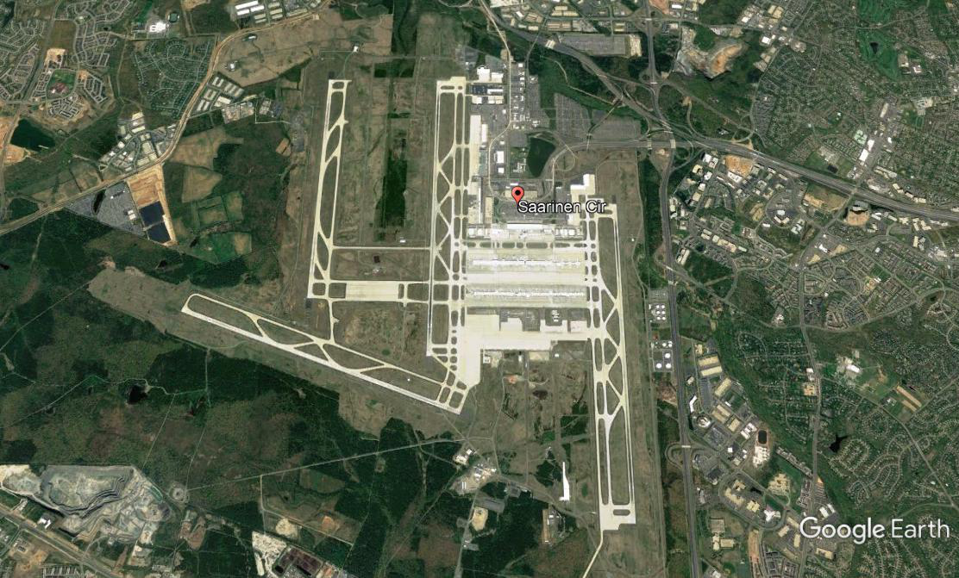

Slide 37
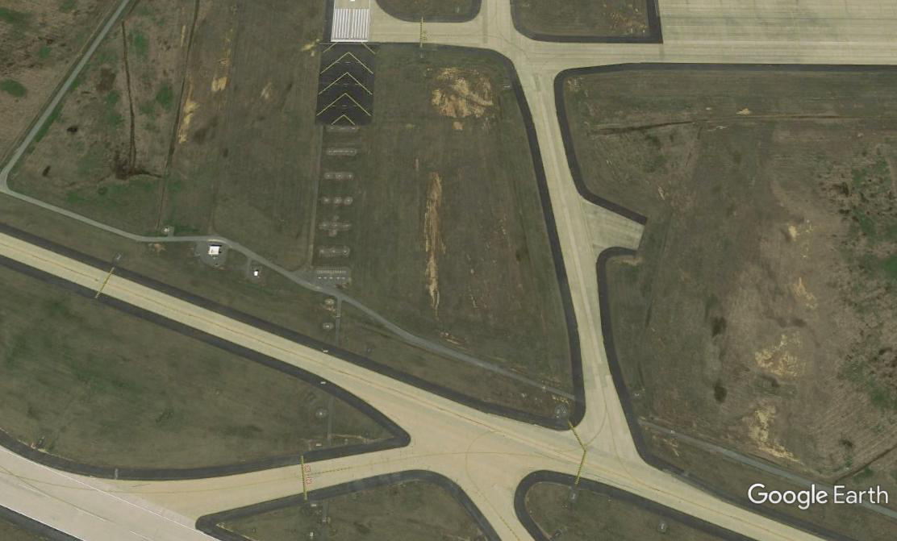
New use of Pattern B (Ladder) Holding Position Marking at Departure/Approach ends.
Comply by July 2020

Slide 38
AC 150/5340-1M
(continued)
Modified enhanced taxiway centerline that
are collinear with an on-center surface
painted holding position sign.

Slide 39
AC 150/5340-1M
2 to 3 ft
3 ft

Slide 40
AC 150/5340-1M
(continued)
When a black border is not painted on a
holding position marking, the taxiway edge
marking stops 6-inches away from the hold
bar.

Slide 41
3 ft.
3 ft.
3 ft.
6 to 12 in.
12 in.
12 in.
12 in.
6 to 12 in.
9 ft.
6 to 12 in.
6 in.
6 in.
6 in.
6 in.
3 ft.
3 to 6 in.

Slide 42

AC 150/5370-10H, Item P-620
Tailored
Specifications
Surface
Preparation
Good Inspection
Quality Materials
Quality Application

Slide 43
AC 150/5370-10H, 12/21/18
  New Construction AC
  Specifications for asphalt, concrete, joints, sealants, etc.
  Item P-620 – Runway and Taxiway Markings – Guidance for HOW to apply markings

Slide 44
AC 150/5370-10H, Item P-620
Runway and Taxiway Markings
Materials to use
Equipment
Material usage
Application requirements
Quality control measures
Retro-reflectivity requirements
The underlying theme with the New Construction AC (5370-10H) is quality, and the markings portion in the P-620 was no exception.

Slide 45
AC 150/5370-10H - P620
Runway and Taxiway Markings
620-2.1 Materials acceptance.
. . . All material shall arrive in sealed containers that are easily quantifiable for inspection by the RPR.

Slide 46
AC 150/5370-10H, P620, Table 1
Paint |  | Glass Beads
Type | Application Rate Maximum | Type I, Gradation A¹ Minimum | Type III Minimum | Type IV¹ Minimum
Waterborne Type I or II [III] | 115 ft²/gal (2.8 m²/l) | 7 lb/gal (0.85 kg/l) | 10 lb/gal (1.2 kg/l) | --
Waterborne Type III | 90 ft²/gal (2.2 m²/l) | 7 lb/gal (0.85 kg/l) | 8 lb/gal (1.0 kg/l)
Waterborne Type III | 55 ft²/gal (1.4 m²/l) |  | 6 lb/gal (.8 kg/l) | 5 lb/gal (.7 kg/l)
Solvent Base | 115 ft²/gal (2.8 m²/l) | 7 lb/gal (0.85 kg/l) | 10 lb/gal (1. 2 kg/l) | --
Solvent Base | 55 ft²/gal (2.2 m²/l) | -- | -- | 5 lb/gal (.7 kg/l)
Epoxy | 90 ft²/gal (2.2 m²/l) | 15 lb/gal (1.8 kg/l) | 20 lb/gal (2.4 kg/l) | 16 lb/gal (1.9 kg/l)
Methacrylate | 45 ft²/gal (1.1 m²/l) | 15 lb/gal (1.8 kg/l) | 20 lb/gal (2.4 kg/l) | 16 lb/gal (1.9 kg/l)
Methacrylate Splatter-Profile | 24ft²/gal. (0.6 m²/l) | 8 lb/gal. (0.1 kg/l) | 10 lb/gal. (1.2 kg/l) | 10 lb/gal (1.2 kg/l)
Temporary Marking Waterborne Type I or II [III] | 230 ft²/gal (5.6 m²/l) | No beads | No beads | No beads
Notes:
Footnote 1 – Red and Pink paint – Type I and IV beads reduced by 2 pounds

Slide 47
AC 150/5370-10H - P620
Runway and Taxiway Markings
620-2.2 – Marking materials.
. . . CAUTION: Prior to reopening pavements at Part 139 airports verify that all markings comply with Part 139 requirements. Temporary markings not in compliance with AC 150/5340-1 will require a NOTAM regarding any non-standard marking be issued. For example, temporary markings without beads.

Slide 48
AC 150/5370-10H - P620
Runway and Taxiway Markings
620-2.2 – Marking materials.
Retroreflectivity shall be measured . . . according to ASTM E1710 and the practices in ASTM D7585 . . . for a portable retro-reflectometer and computing measurement averages. A vehicle-mounted retroreflectometer may also be used.

Slide 49
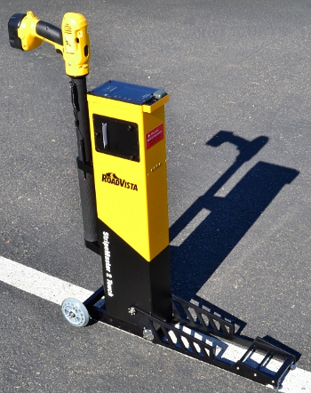
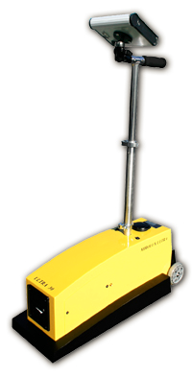
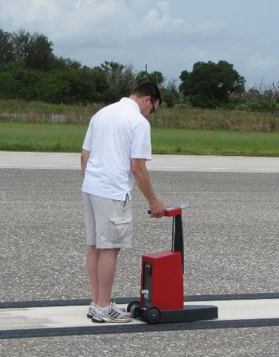
Retro-reflectometers
  Stripemaster II
  Mirolux 30
  Delta Optics LTL-X

Slide 50
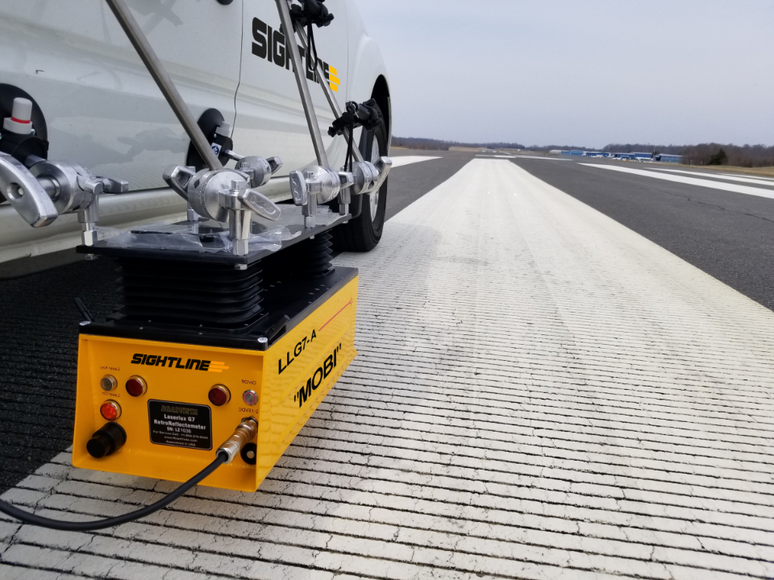

Slide 51
Minimum Retro-reflectance Values
Material | Retro-reflectance mcd/m²/lux
 | White | Yellow | Red
Initial Type I | 300 | 175 | 35
Initial Type III | 600 | 300 | 35
Initial Thermoplastic | 225 | 100 | 35
All materials, remark when less than¹ | 100 | 75 | 10
1
Prior to remarking, determine if removal of contaminants on markings will restore retro-reflectance.

Slide 52
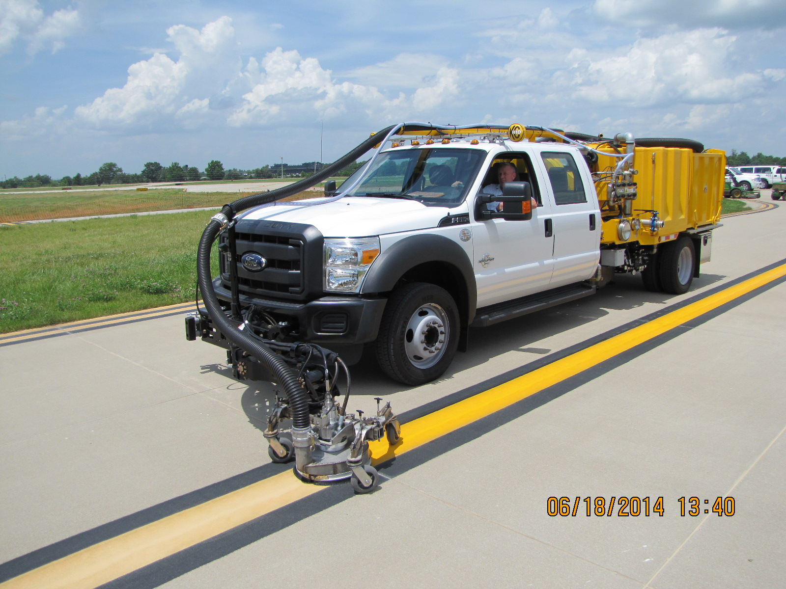

Slide 53
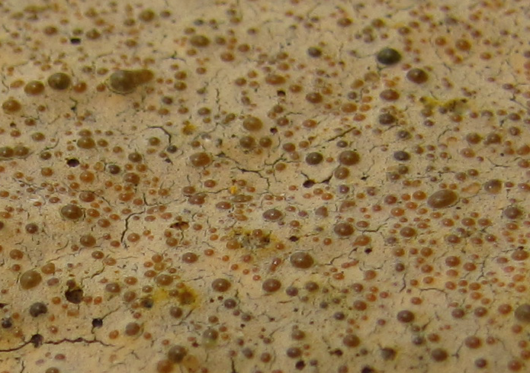

Slide 54
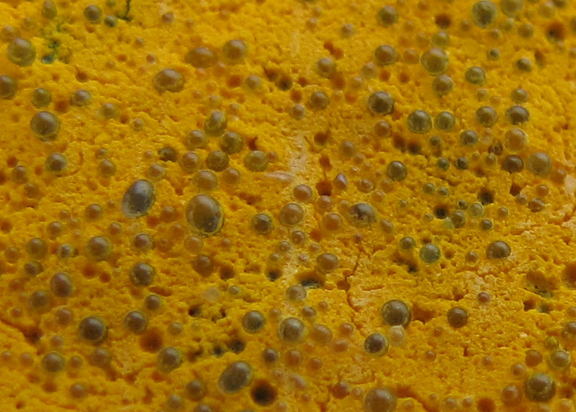

Slide 55
AC 150/5370-10H - P620
Runway and Taxiway Markings
620-2.2 – Marking materials.
b. Reflective media. Glass beads for red and pink paint shall meet the requirements for [Type I, Gradation A] [ Type IV, Gradation A].
(Should be Gradation B)

Slide 56
900
750
600
450
300
150
0
NOTE: Suggested performance at installation.
Wait at least 24 hours to evaluate reflectivity.
600
retrorefectivity (mcd)
300
300
40
35
30
25
20
15
10
5
0
175
1016
889
762
635
508
381
254
127
0
mils
microns
Type I
Gradation A
Low Index
(1.5 IOR)
Recycled Glass
Type III
High Index
(1.9 IOR)
Virgin Materials
Type IV
Gradation B
Low Index
(1.5 IOR)
Direct Melt
Type IV
Gradation A
Low Index
(1.5 IOR)
Direct Melt

Slide 57
AC 150/5370-10H - P620
Runway and Taxiway Markings
Released December 21, 2018
620-3.1 – Weather Limitations
Markings shall not be applied when weather conditions are forecast to not be within the manufacturer’s recommendations for application and dry time. [cure time]
This could be applied to marking maintenance.

Slide 58
AC 150/5370-10H - P620
Runway and Taxiway Markings
620-3.2 – Equipment
The mechanical marker shall be an atomizing spray-type or airless type marking machine with automatic glass bead dispensers suitable for application of traffic paint. It shall produce an even and uniform film thickness and appearance of both paint and glass beads at the required coverage and shall apply markings of uniform cross-sections and clear-cut edges without running or spattering and without over spray. The marking equipment for both paint and beads shall be calibrated daily.
This could be applied to marking maintenance.

Slide 59
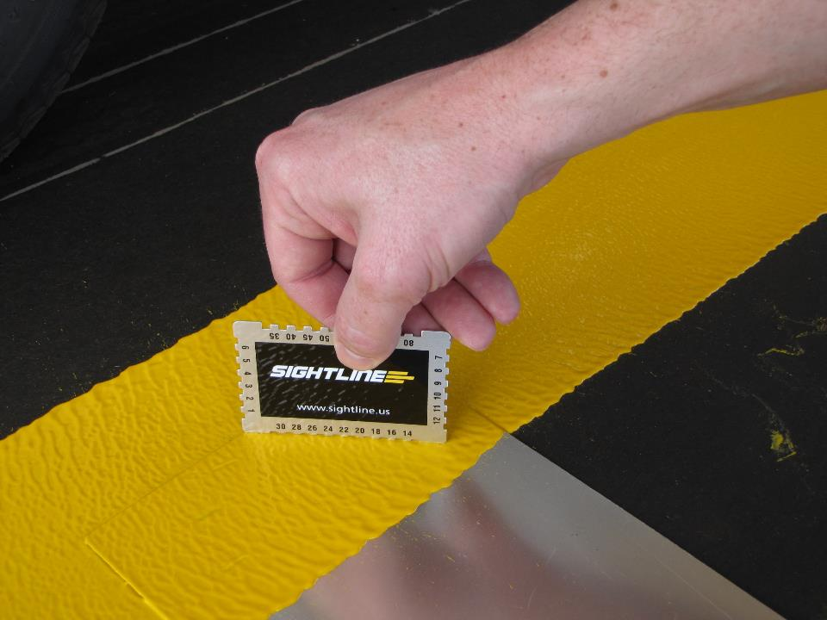

Slide 60
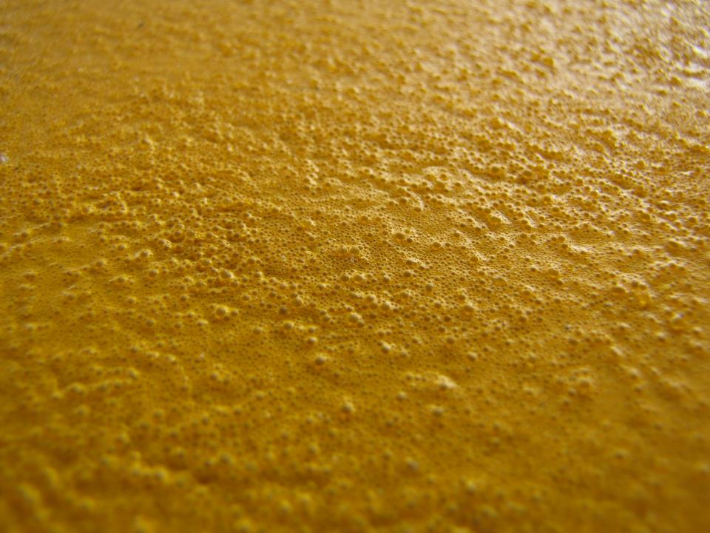

Slide 61
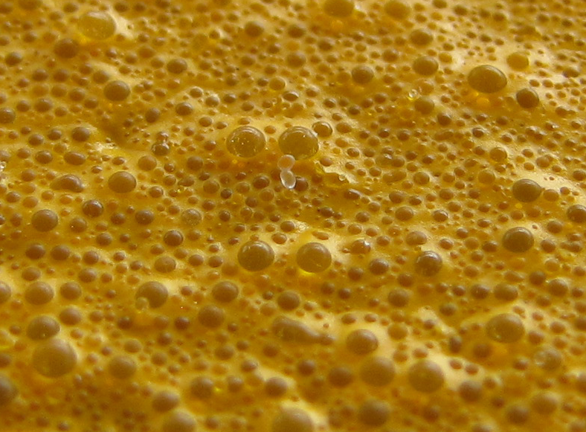

Slide 62
AC 150/5370-10H - P620
Runway and Taxiway Markings
620-3.3(a) – Surface Preparation = Clean new pavements
Preparation of new pavement surfaces.
The area to be painted shall be cleaned by broom, blower, water blasting, or by other methods approved by the RPR to remove all contaminants, including PCC curing compounds, minimizing damage to the pavement surface.
This would not be applied to marking maintenance.

Slide 63
AC 150/5370-10H - P620
Runway and Taxiway Markings
620-3.3(b) – Surface Preparation = Paint Removal
b. Preparation of pavement to remove existing markings. Existing pavement markings shall be removed by rotary grinding, water blasting, or by other methods approved by the RPR minimizing damage to the pavement surface. The removal area may need to be larger than the area of the markings to eliminate ghost markings. After removal of markings on asphalt pavements, apply a fog seal or seal coat to ‘block out’ the removal area to eliminate ‘ghost’ markings.

Slide 64
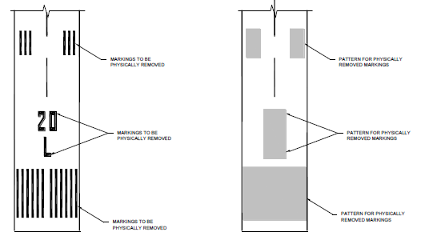
Para 1.3(f) The physical removal of any old marking(s)
must include a pre-determined larger size and shape of
a removal area that encompasses the old marking(s).

Slide 65
AC 150/5370-10H - P620
Runway and Taxiway Markings
620-3.3(b) – Surface Preparation = Paint Removal
b. Preparation of pavement to remove existing markings. Existing pavement markings shall be removed by rotary grinding, water blasting, or by other methods approved by the RPR minimizing damage to the pavement surface. The removal area may need to be larger than the area of the markings to eliminate ghost markings. After removal of markings on asphalt pavements, apply a fog seal or seal coat to ‘block out’ the removal area to eliminate ‘ghost’ markings.

Slide 66
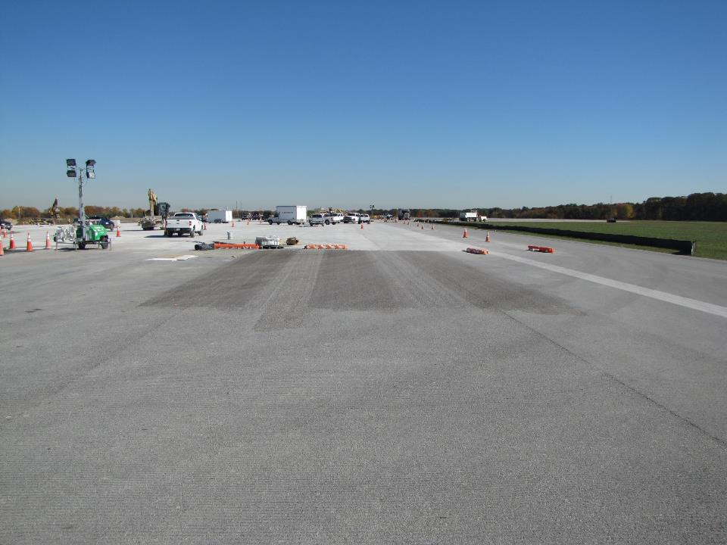

Slide 67
AC 150/5370-10H - P620
Runway and Taxiway Markings
620-3.3(c) – Surface Preparation = Before repainting
c. Preparation of pavement markings prior to remarking. Prior to remarking existing markings, loose, existing markings must be removed minimizing damage to the pavement surface, with a method as approved by the RPR. After removal, the surface shall be cleaned of all residue or debris.

Slide 68
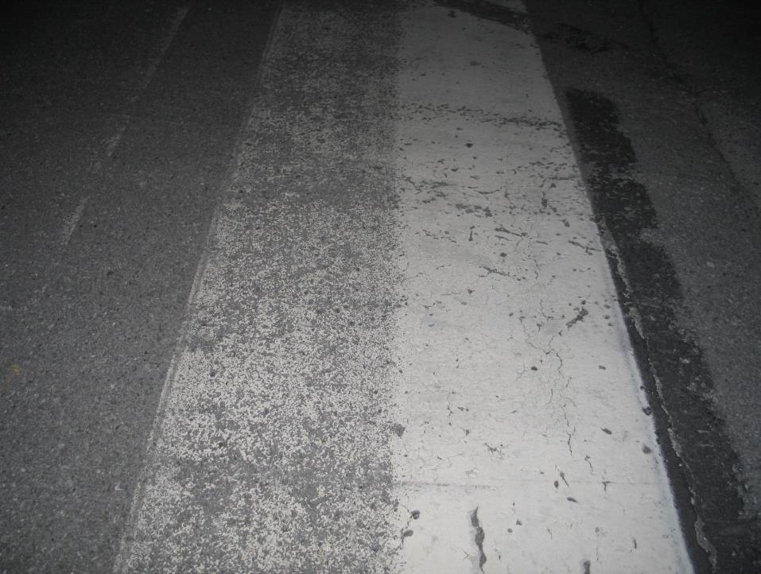
Loose and poorly bonded material was removed by waterblasting.
No surface preparation has taken place
This could be applied to marking maintenance.

Slide 69
AC 150/5370-10H - P620
Runway and Taxiway Markings
620-3.5 – Application
Different bead types shall not be mixed. Regular monitoring of glass bead embedment and distribution should be performed.
This could be applied to marking maintenance.

Slide 70


Slide 71
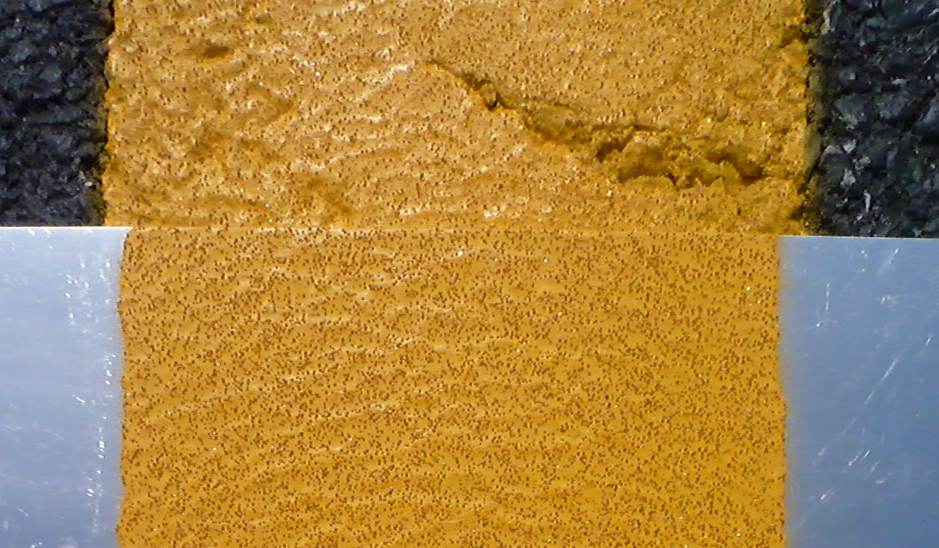

Slide 72
AC 150/5370-10H - P620
Runway and Taxiway Markings
620-3.7 – Control Strip
Prior to the full application of airfield markings, the Contractor shall prepare a control strip in the presence of the RPR. The Contractor shall demonstrate the surface preparation method and all striping equipment to be used on the project. The marking equipment must achieve the prescribed application rate of paint and population of glass beads (per Table 1) that are properly embedded and evenly distributed across the full width of the marking. Prior to acceptance of the control strip, markings must be evaluated during darkness to ensure a uniform appearance.
This could be applied to marking maintenance.

Slide 73
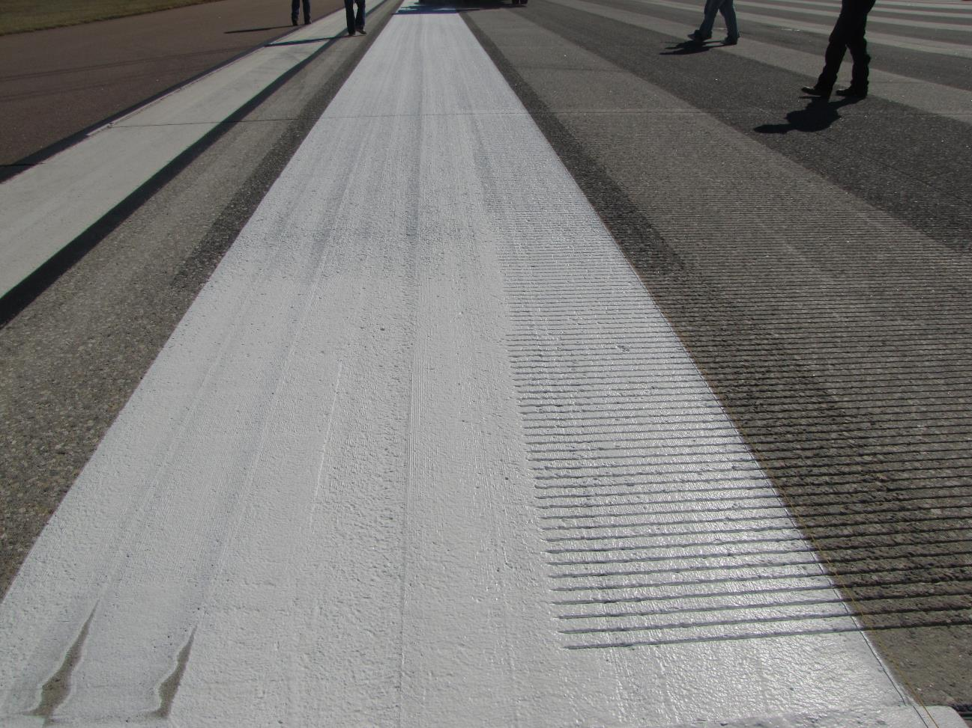

Slide 74
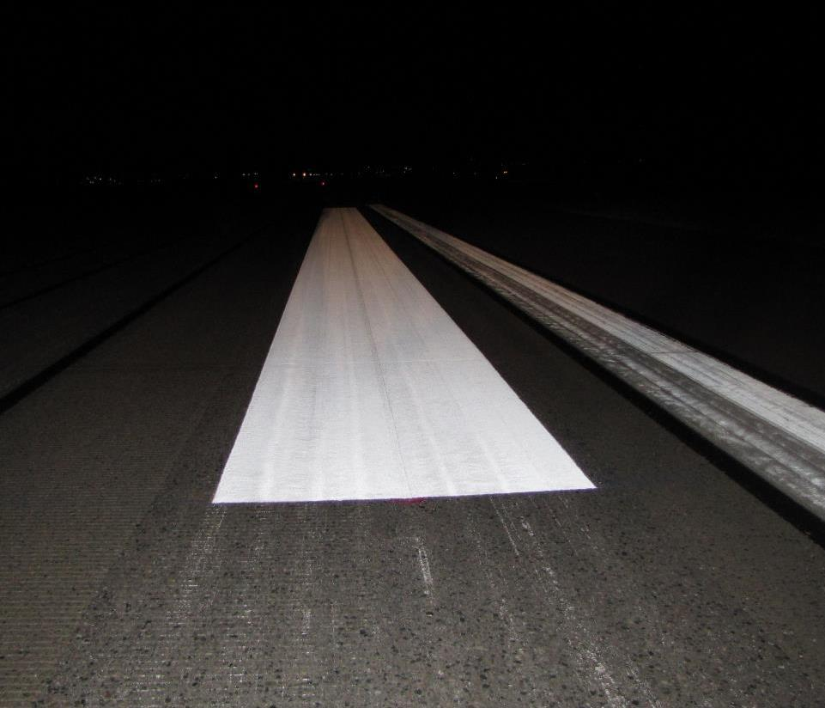
Calibrated Control Strip – Inspect during darkness

Slide 75
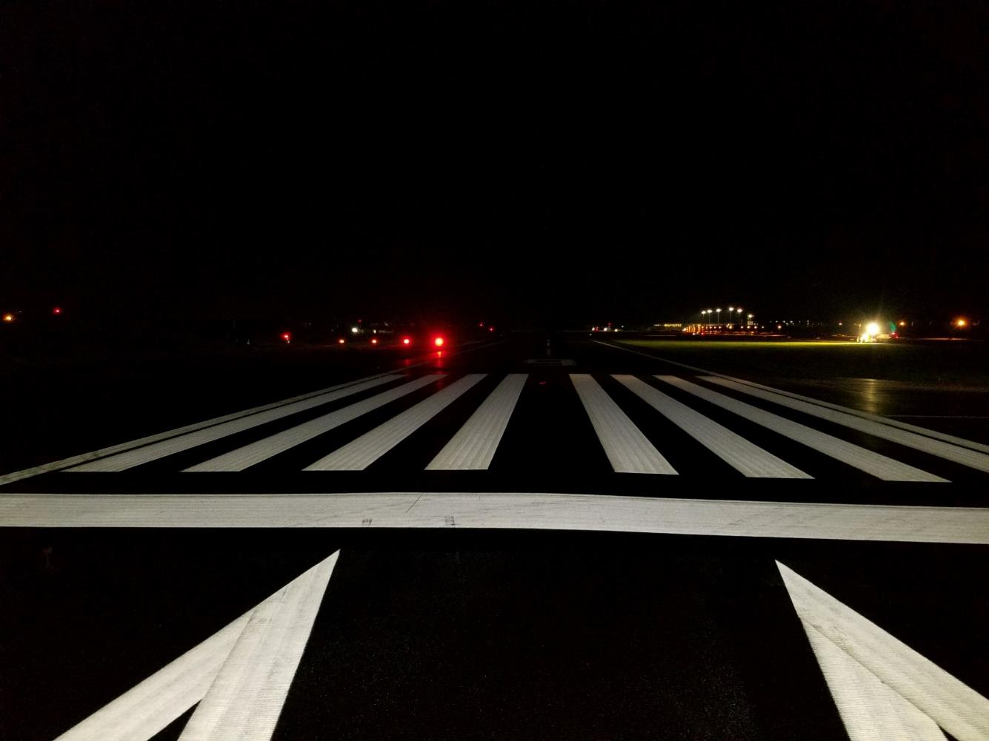
This is the icing on the cake

Slide 76
AC 150/5370-10H - P620
Runway and Taxiway Markings
620-3.8 – Retro-Reflectance
Reflectance shall be measured . . . The average shall be equal to or above the minimum levels of all readings which are within 30% of each other.
This could be applied to marking maintenance.

Slide 77
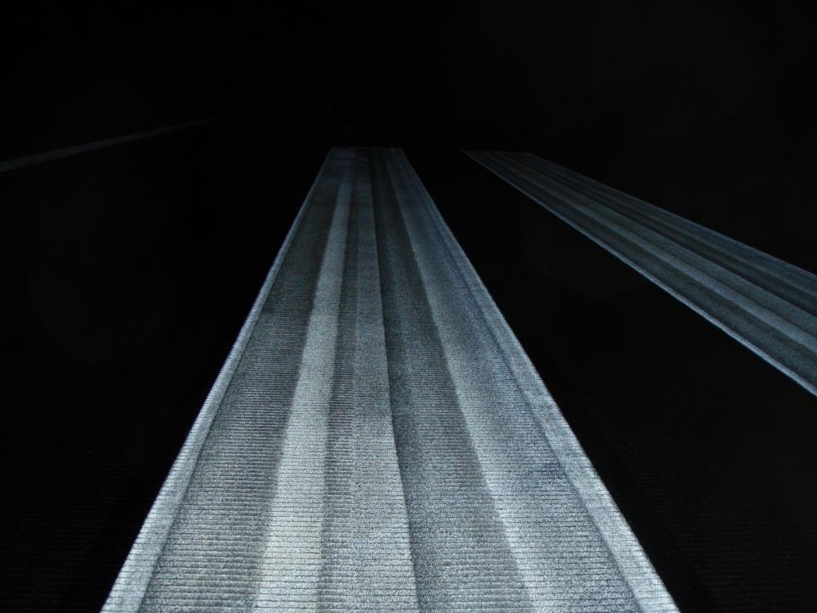
180
303
380
Average = 1404/6 = 234
234 x .30 = 70
234 + 35 = 269
234 – 35 = 199
185
170
186

Slide 78
AC 150/5370-10H - P620
Runway and Taxiway Markings
METHOD OF MEASUREMENT
620-4.1a The quantity of surface preparation shall be measured by [the number of square feet for each type of surface preparation specified in paragraph 620-3.3 ] [ lump sum ]
620-4.1b The quantity of markings . . .
620-4.1c The quantity of reflective media . . .
620-4.1d The quantity of temporary markings . . .
620-4.1e The quantity of preformed markings . . .

Slide 79
AC 150/5370-10H – P101
Preparation/Removal of Existing Pavements
101-3.3 Removal of paint and rubber prior to [overlay][seal coat]. All paint and rubber over 1 foot wide that will affect the bond of the new [overlay][seal coat] shall be removed from the surface of the existing pavement.

Slide 80
Quality built into markings = dollar savings
Tailored
Specifications
Surface
Preparation
Good Inspection
Quality Materials
Quality Application

