Slide 1
Electrical Contractors
Since 1953
Jared M. Barfield
Vice-President, Carolinas Division

Slide 2
Company Overview
Based Out Of: Mableton, GA
Local Office: Charlotte, NC
Current No. Of Employees: 240 Over Four States
2019 FY Earnings: $80MM+
Coverage Area: Georgia, Alabama, Florida, Tennessee, South Carolina, and North Carolina

Slide 3
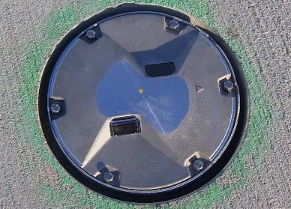
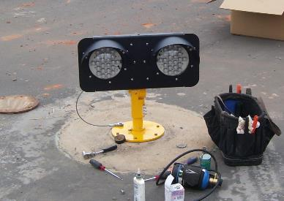
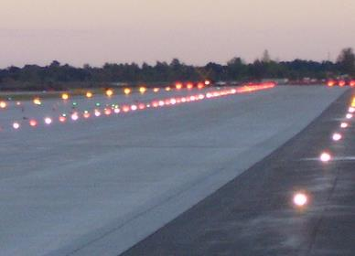
What are we here to talk about?
Runway Lighting
Threshold
Centerline
Edge
Touchdown Zone (TDZ)
Takeoff Hold Lighting (THL’s)
Taxiway Lighting
Centerline
Edge
Guard
Stop Bar
Runway Entrance Lights (REL’s)
Airfield Guidance Signs

Slide 4
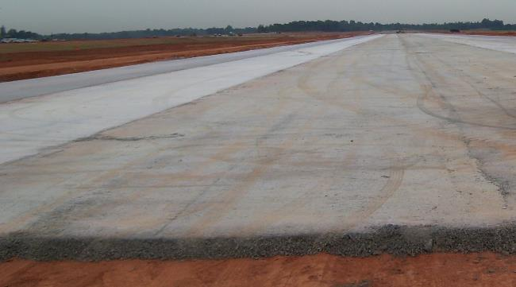
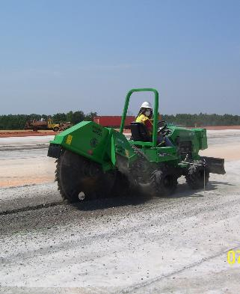
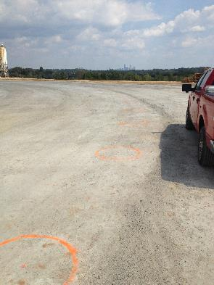
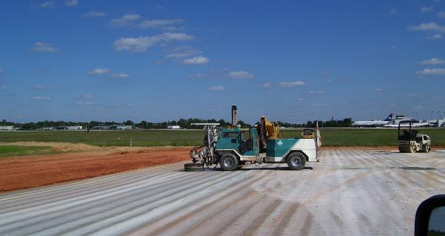
Normal Airfield Lighting Installation Phases
General Contractor established sub grade and sub base.
Lighting centerlines laid out.
Conduit Installed

Slide 5
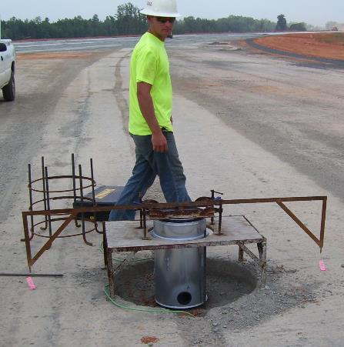
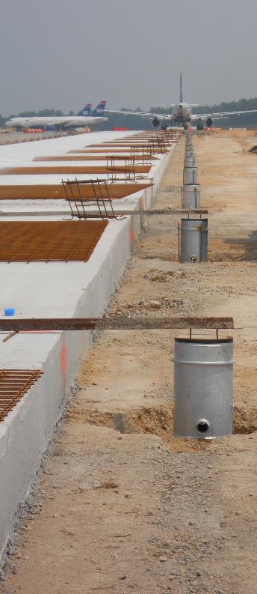
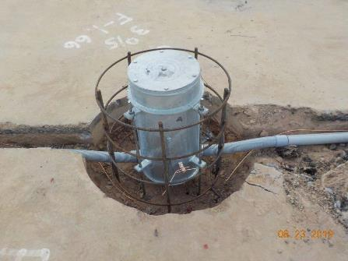
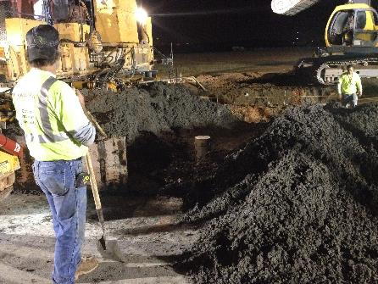
Normal Airfield Lighting Installation Phases
Light Bases Installed (If PCC Pavement)
Pavement Placed

Slide 6
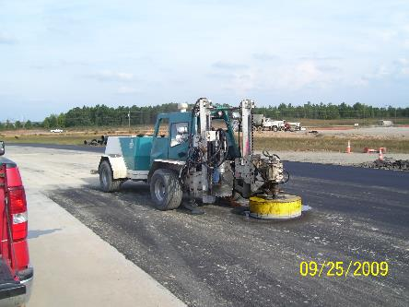
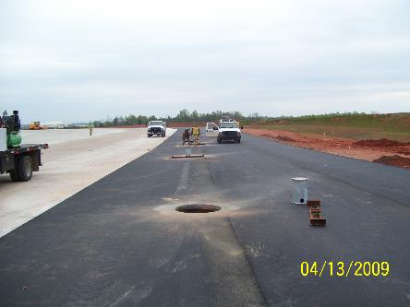
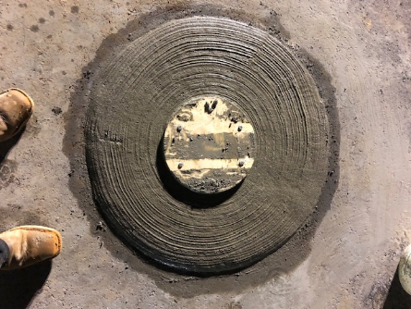
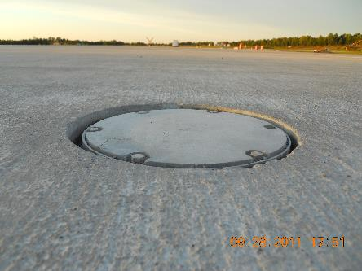
Normal Airfield Lighting Installation Phases
Light Bases Cored and Placed (If in Shoulder Pavement.
Wire and Transformers Installed.

Slide 7
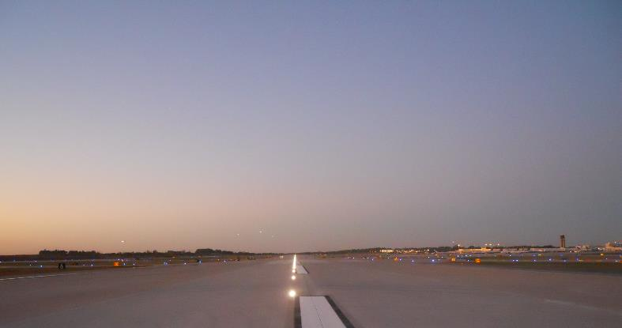
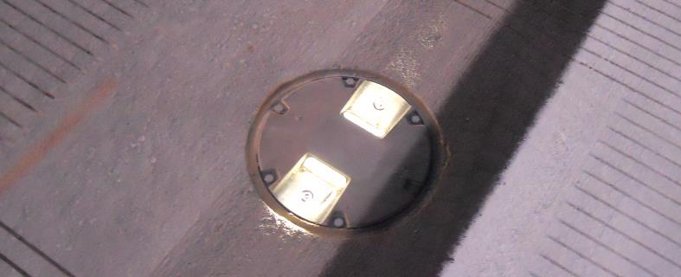
Normal Airfield Lighting Installation Phases
Spacers, Rings, and Fixtures Installed.
System Terminated, Tested, and Energized.
Sealing.

Slide 8
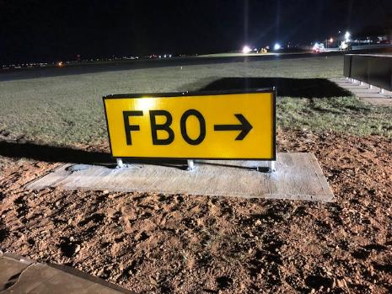
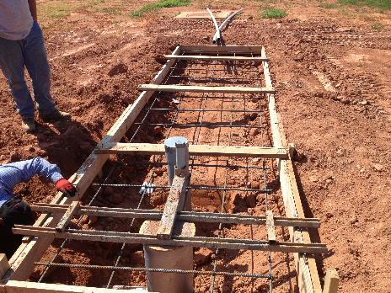
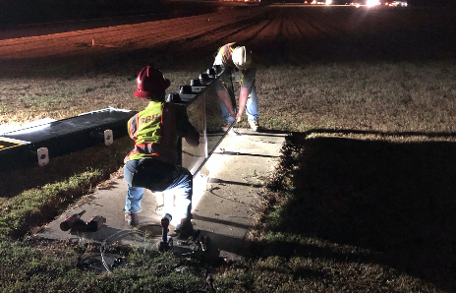
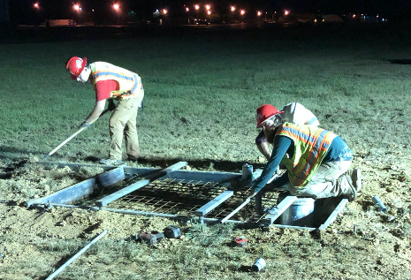
Normal Airfield Lighting Installation Phases
Airfield Guidance Signs

Slide 9
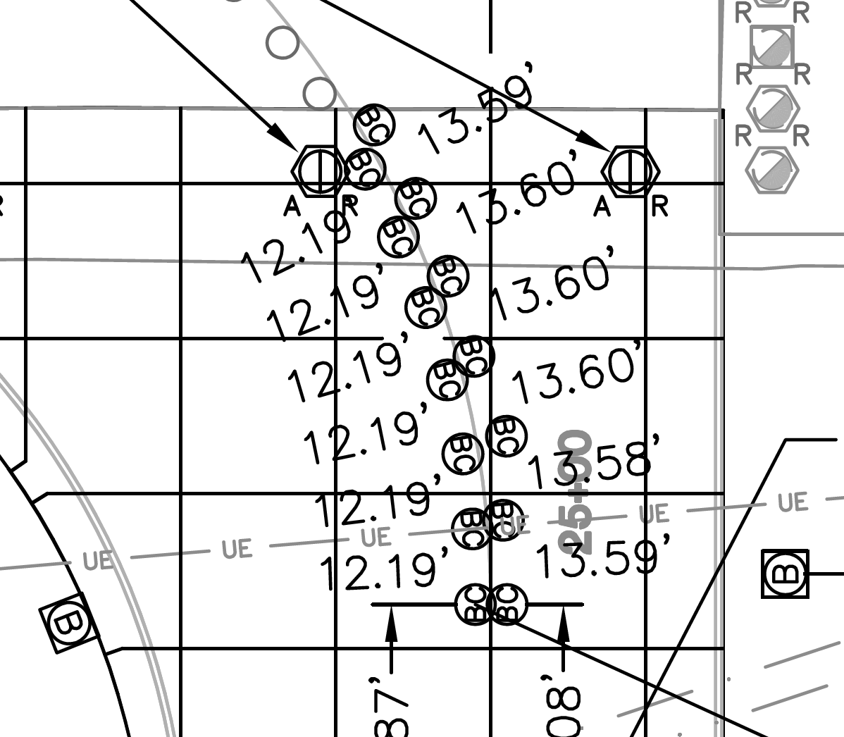
Common Issues Facing an Electrical Contractor
Joint Conflicts Between Light Cans and PCC Pavement Joints

Slide 10
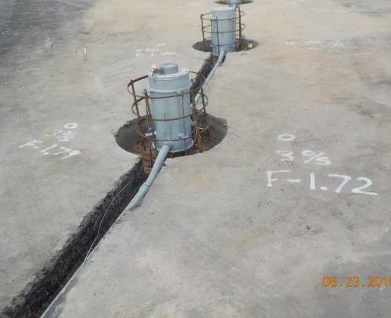
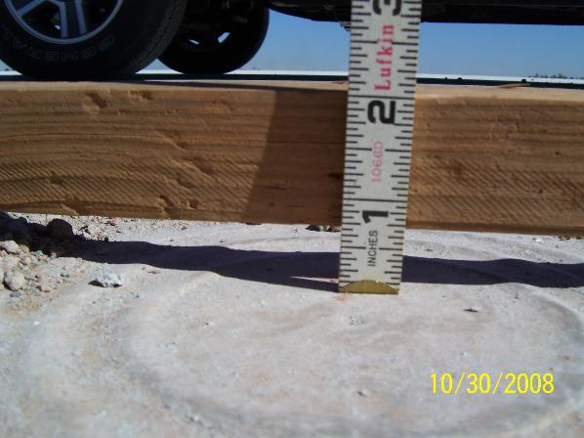
Common Issues Facing an Electrical Contractor
Survey
Prompt, Accurate Survey is Critical To Installation.
FAA Advisory Circular 150/5340-30D
Top of Fixture Edge Must Be +0 and -1/16” From Pavement Surface.
Required Aim Tolerance (Azimuth) +/- 1/2 Degree

Slide 11
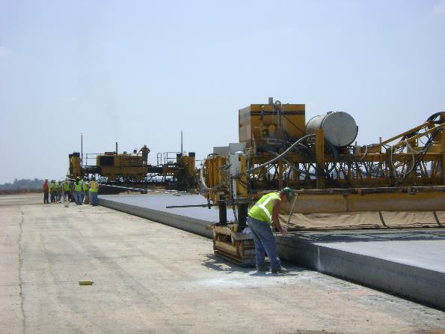
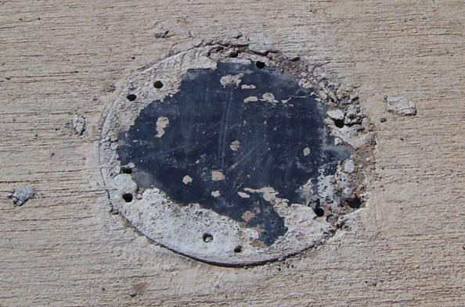
Common Issues Facing an Electrical Contractor
Paving Accuracy
Small Variations In Paving Can Mean Costly Repairs
Repairs Include Spacer Rings, Tapered Rings, Removal And Replacement of the Base Can, or Complete Slab Removal.
Workmanship
Having a well trained workforce with the proper materials and tooling for the task is critical.

Slide 12
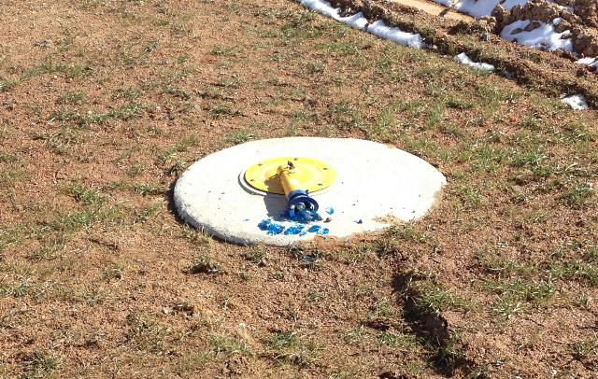
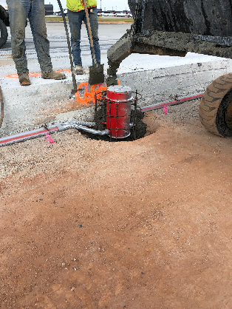
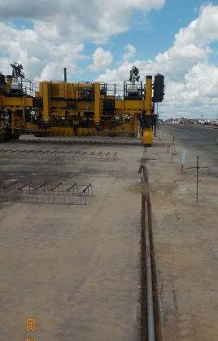
Common Issues Facing an Electrical Contractor
Other Issues:
Adequate Time For Installation of Electrical Work
Coordination With Paving Operations
Small Batch Concrete
Material Procurement (Steel Products)
Damage to Completed Work

Slide 13
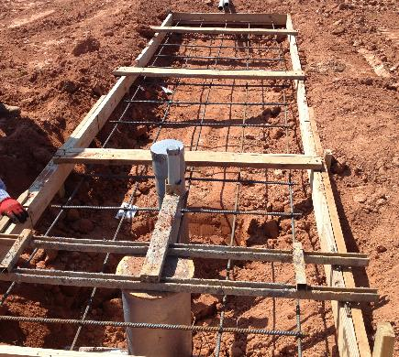
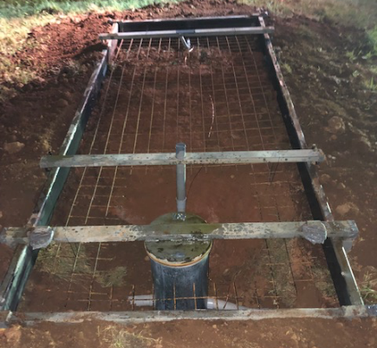
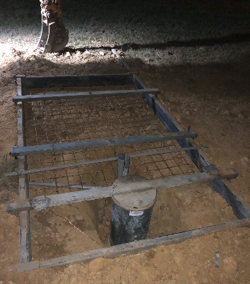
Success Stories

Slide 14
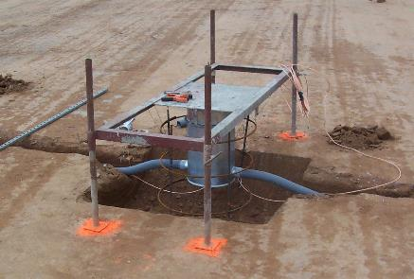
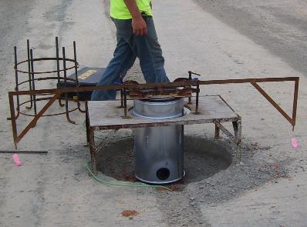
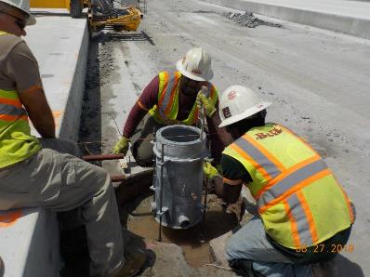
Success Stories

Slide 15
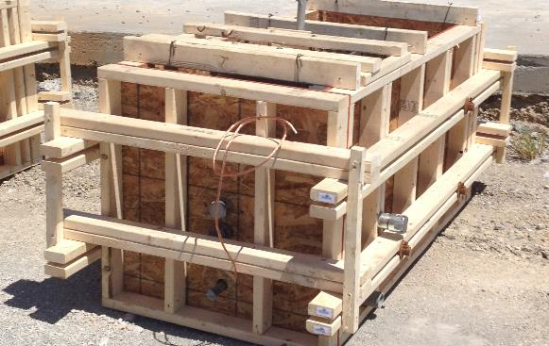
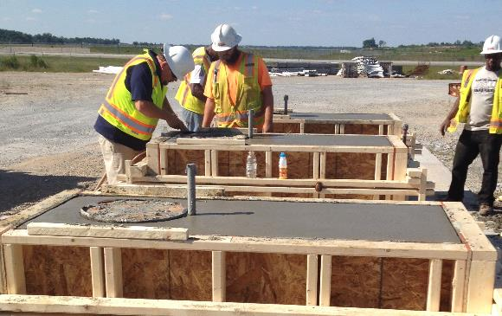
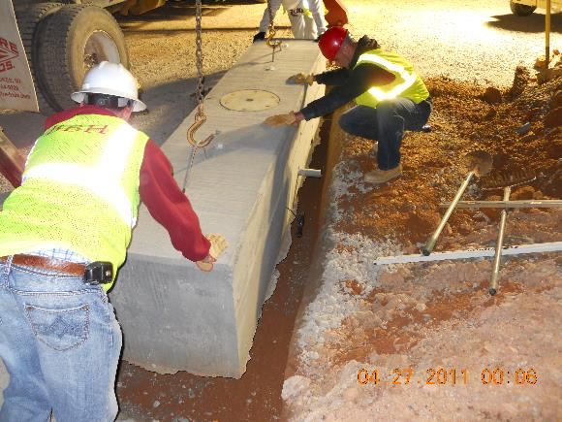
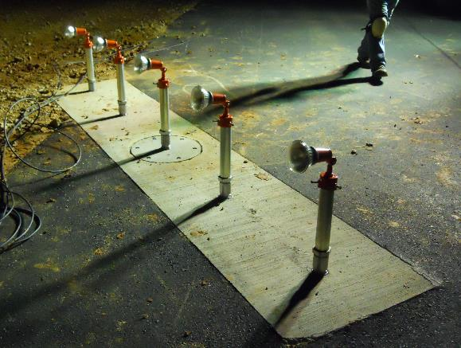
Success Stories

Slide 16
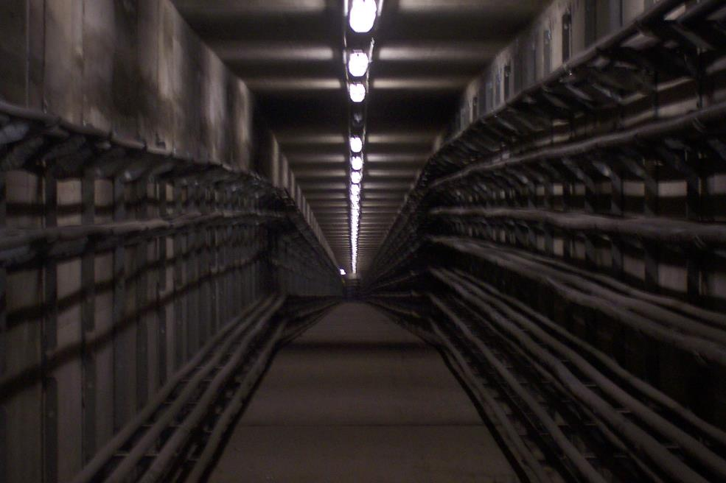
Project Highlights

Slide 17
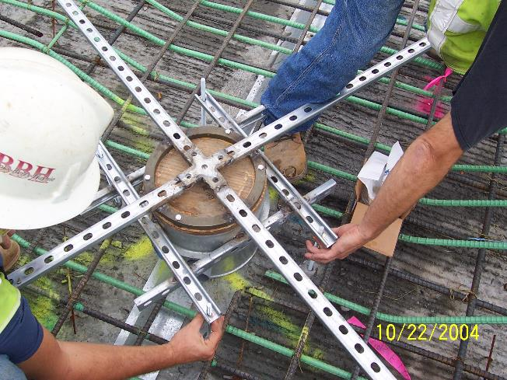
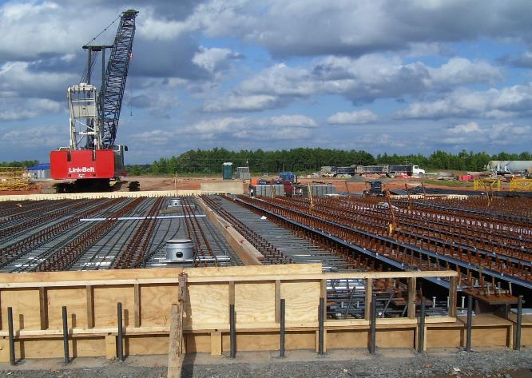
Project Highlights
Taxiway N&S Bridge Construction
Charlotte Douglas International Airport
I-285 Bridge Structures
Hartsfield-Jackson International Airport

Slide 18
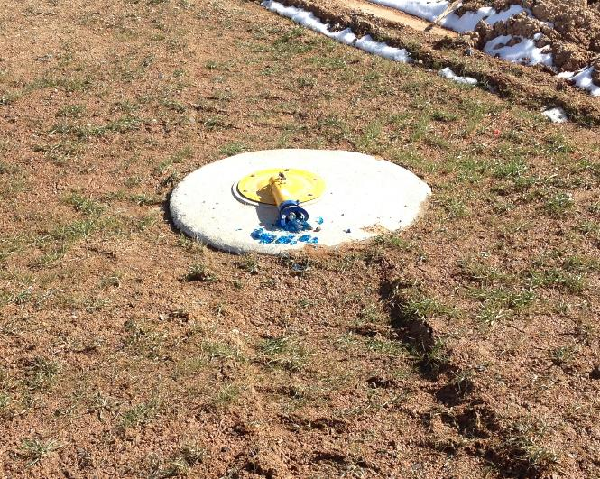
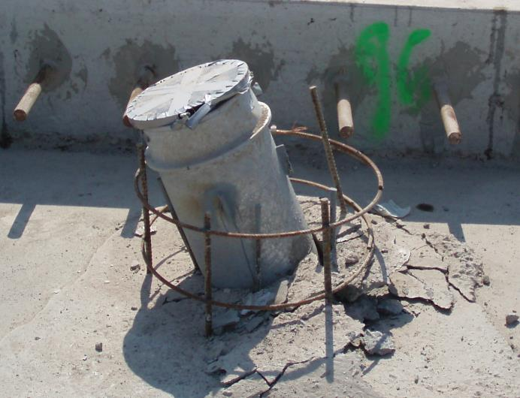
Oooops…

